Slide 1

How To Speak Tech and What To Expect From a Tech Career
Aviwe Qata
22 February 2023

Slide 2





Aviwe Qata
Notes:
I am a BeyHive member through and through

Slide 3



About me
Notes:
I love running, coffee and that is me and my godson West ☺
Today we are going to talk about various roles in tech while we learn some cool new terms.

Slide 4
Table Of Contents
01.
02.
What Is Software Development?
Software Development Life Cycle (SDLC)

Slide 5
Table Of Contents
04.
05.
Software Methodologies
The Scrum Framework
06.
Careers In Tech

Slide 6


Slide 7

01.
What Is Software Development?

Slide 8
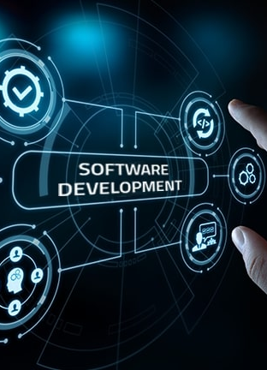
What Is Software Development?
What Is Software Development?
Software development – computer science activities dedicated to creating, designing, deploying and supporting software.
Software – set of instructions or programs that tell a computer what to do.

Slide 9
Here are three basic differentiators
What Is Software Development?
System Software
Programming Software
Application Software
Core functions including operiting systems, disk management, utilities and hardware management. For example Windows.
Give programers tools to create code like, text editors, compilers and linkers debbuggers. For example Python.
Helps users perform tasks, this includes data management software and media players. For example Amazon.com.
Notes:
System software to provide core functions such as operating systems, disk management, utilities, hardware management and other operational necessities.
Programming software to give programmers tools such as text editors, compilers, linkers, debuggers and other tools to create code.
Application software (applications or apps) to help users perform tasks. Office productivity suites, data management software, media players and security programs are examples. Applications also refers to web and mobile applications like those used to shop on Amazon.com, socialize with Facebook or post pictures to Instagram.

Slide 10

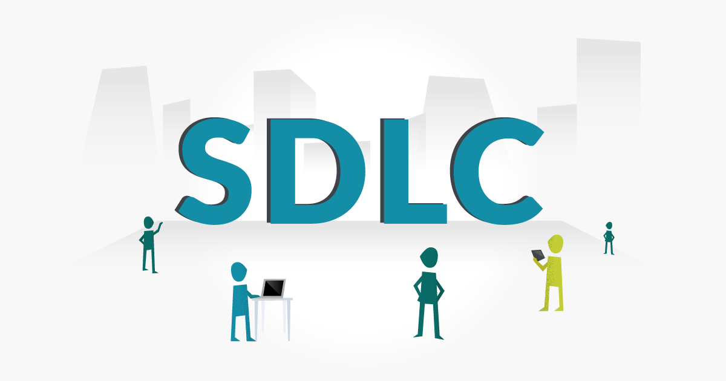
Software Development Life Cycle (SDLC)
02.

Slide 11
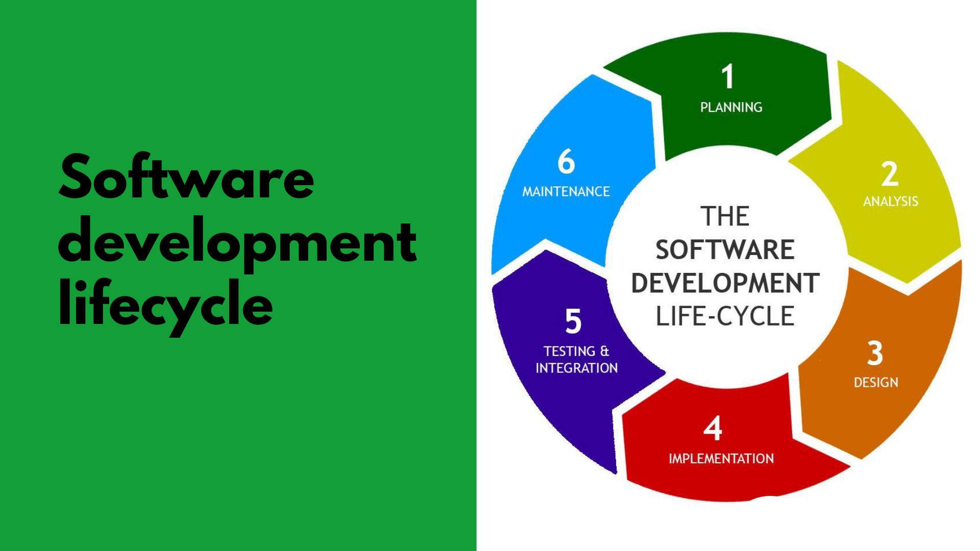
SDLC
Notes:
What is SDLC - This is a process that helps produce software, it involves distinctive phases to initiate software production based on client requirements.

Slide 12
Scenario!
SDLC
Bob is moving to Japan, and he would like a friendship application that will help him meet new people in Japan. Using the SDLC let's create the various steps that can help Bob achieve this application
Notes:
Bob is moving to Japan, and he would like a friendship application that will help him with meeting new people in Japan

Slide 13

Planning Stage
SDLC
Define the problem and scope of any existing systems

Slide 14

Planning Stage
SDLC
The purpose of the application

Slide 15

Planning Stage
SDLC
Working out cost estimation with stakeholders
Notes:
What are the sort of initial questions are we going to ask Bob at this planning stage?

Slide 16
Planning Stage
SDLC
Defining and understanding timelines
Notes:
Why is it important to know the clients' timelines
This might be due to targeted deadlines in terms of market placing

Slide 17
Analysis Stage
SDLC
Eliciting all the specific details required for the new system

Slide 18
Analysis Stage
SDLC
The details about the end-user of the product

Slide 19
Analysis Stage
SDLC
Calibrating security protocols and performing risk analysis

Slide 20
Analysis Stage
SDLC
Documenting requirements
Notes:
How will we get the information we need about the friendship site?
Interviews, research, discussion groups etc.
What could we use to document these requirements?
Software requirement specification

Slide 21
Design Stage
SDLC
Devise the system following analyst documentation
Notes:
Looking at the business requirements written in the analysis phase, use that document to design the system

Slide 22

Design Stage
SDLC
Check feasibility with requirements
Notes:
The project evaluates the system's impact, functionality, and performance before investing in its development from a design perspective.

Slide 23
Design Stage
SDLC
Document the systems designs
Notes:
What document type would we use to document these designs?
Design Document Specification

Slide 24
Design Stage
SDLC
Share document for review with analyst and stakeholders
Notes:
Making sure designs are communicating both the requirements and end-user needs.

Slide 25
Development Stage
SDLC
The actual development starts, and the product is built
Start writing code using chosen programming language(s)
Notes:
What code be some of the languages used to develop this application?
Phyton, Java, C# etc

Slide 26
Development Stage
SDLC
One of the most important phases as it encapsulates the implementation of the software product

Slide 27
Development Stage
SDLC
Development tools used like compilers and debuggers to implement the code
Notes:
What could cause a lag in the development of this site?

Slide 28
Testing & Integration Stage
SDLC
Software is deployed in multiple test environments
Check functioning of all the attributes in the software

Slide 29
Testing & Integration Stage
SDLC
Detect any defects
Continue testing until system is stable and user friendly
Notes:
This encompasses functional and non-functional testing
Functional – does system work with no defects
Non-Functional – user friendly, fast, load testing (number of users using system)
What do you think happens when we find problems with the system at this testing stage?

Slide 30
Testing & Integration Stage
SDLC
Ready for deployment and consumer use
Development team will setup installation link for the users
Notes:
Integration stage - type of software testing in which the different units, modules or components of a software application are tested as a combined entity.
If Bobs site needed a payment system, we would need to test the whole system with the payment combination

Slide 31
Maintenance Stage
SDLC
Debugging of the application is done on a regular basis
Regular updates with enhanced features
Notes:
What might be new features that we would want to add to Bob’s Friendship site?

Slide 32
Activity!
Notes:
Going through the SDLC in breakout rooms
10 minutes max

Slide 33
Solution!
Notes:
Going through the SDLC in breakout rooms
10 minutes max

Slide 34

03.
Software Methodologies
Notes:
There are software methodologies used to implemented the SDLC
We will be discussing in detail two of these methodologies and them briefly look at four more

Slide 35
Waterfall
Software Methodologies
The waterfall model is a breakdown of project activities into linear sequential phases
Finishes one phase before another beginnings
Notes:
The waterfall model is a breakdown of project activities into linear sequential phases, meaning they are passed down onto each other, where each phase depends on the deliverables of the previous one and corresponds to a specialization of tasks.
The approach is typical for certain areas of engineering design.

Slide 36
Waterfall
Software Methodologies
Requirements
Concept or idea of what the customer wants
Design
Implementation
Verification
Deployment and Maintenance

Slide 37
Waterfall
Software Methodologies
Requirements
Concept or idea of what the customer wants
Design
Logical design and physical design
Implementation
Verification
Deployment and Maintenance

Slide 38
Waterfall
Software Methodologies
Requirements
Concept or idea of what the customer wants
Design
Logical design and physical design
Implementation
Building the design into actual software
Verification
Deployment and Maintenance

Slide 39
Waterfall
Software Methodologies
Requirements
Concept or idea of what the customer wants
Design
Logical design and physical design
Implementation
Building the design into actual software
Verification
Testing software against the requirements
Deployment and Maintenance

Slide 40
Waterfall
Software Methodologies
Requirements
Concept or idea of what the customer wants
Design
Logical design and physical design
Implementation
Building the design into actual software
Verification
Testing software against the requirements
Deployment and Maintenance
Release of the new software and ongoing deployment/maitenance

Slide 41
When is the Waterfall methodology used?
Notes:
Waterfall can be good when you have all the necessary requirements and chances of them changing are slim
E.G Logging in functionality!

Slide 42
Agile
Software Methodologies
An iterative approach to software development
Agile teams deliver work in small increments
Notes:
An iterative approach to software development that helps teams deliver value to their customers faster and with fewer headaches
Instead of betting everything on a "big bang" launch, an agile team delivers work in small, but consumable, increments.

Slide 43
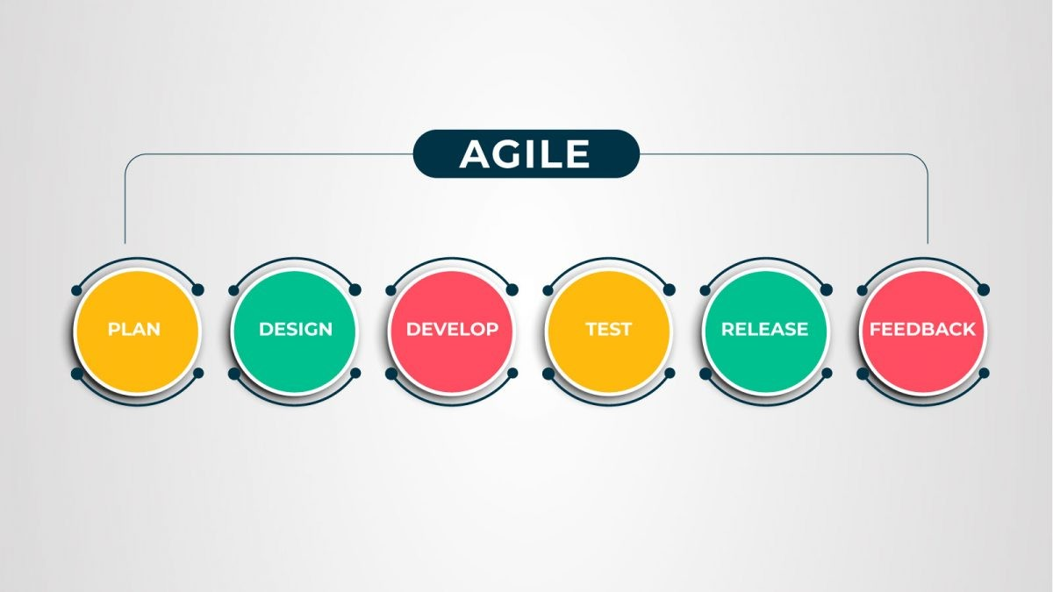
Software Methodologies
Notes:
Full view of the process steps taken in Agile
These are steps can also be performed in parallel

Slide 44
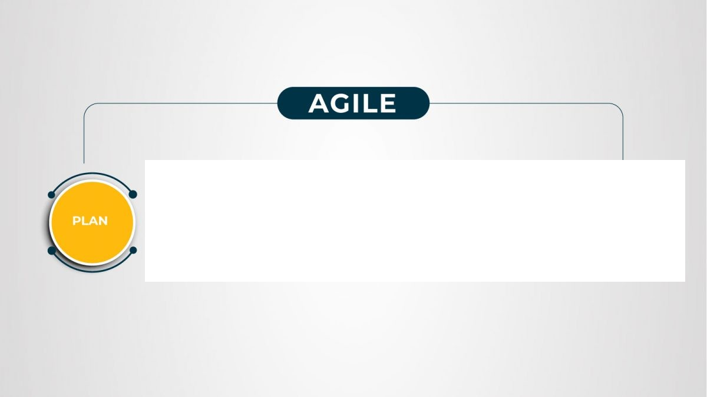
Software Methodologies
Notes:
Analysis of the concepts and requirements definition
Determine current state and stakeholder expectations

Slide 45
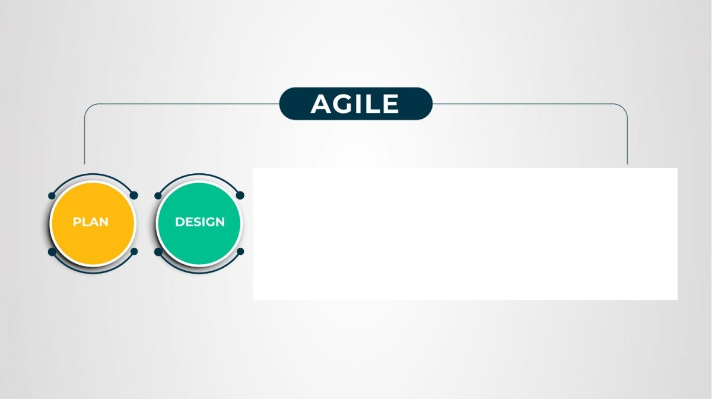
Software Methodologies
Notes:
Collaborative designing and end user involvement and feedback is critical

Slide 46
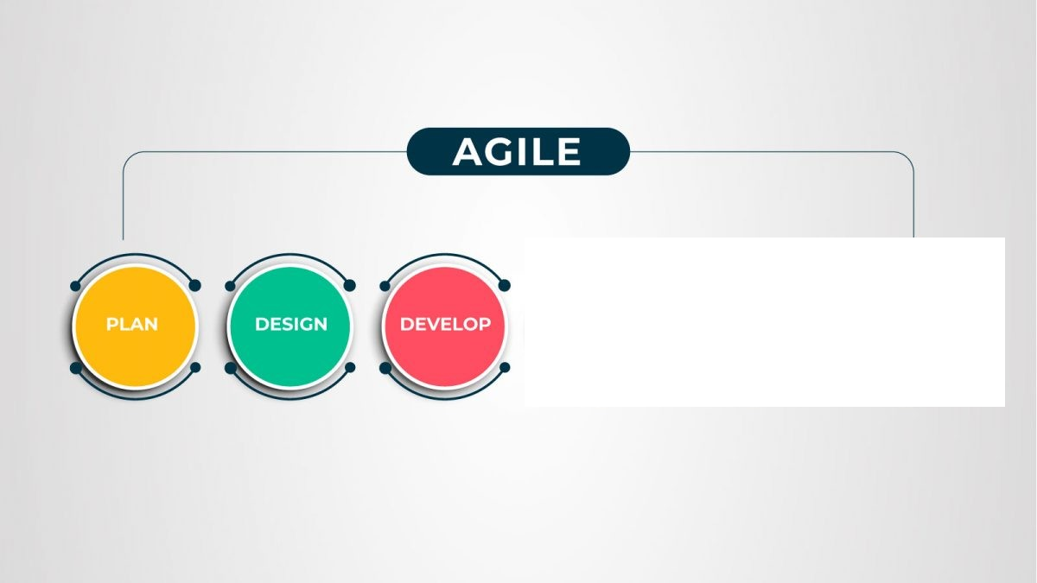
Software Methodologies
Notes:
Frequent development delivery through sprints

Slide 47
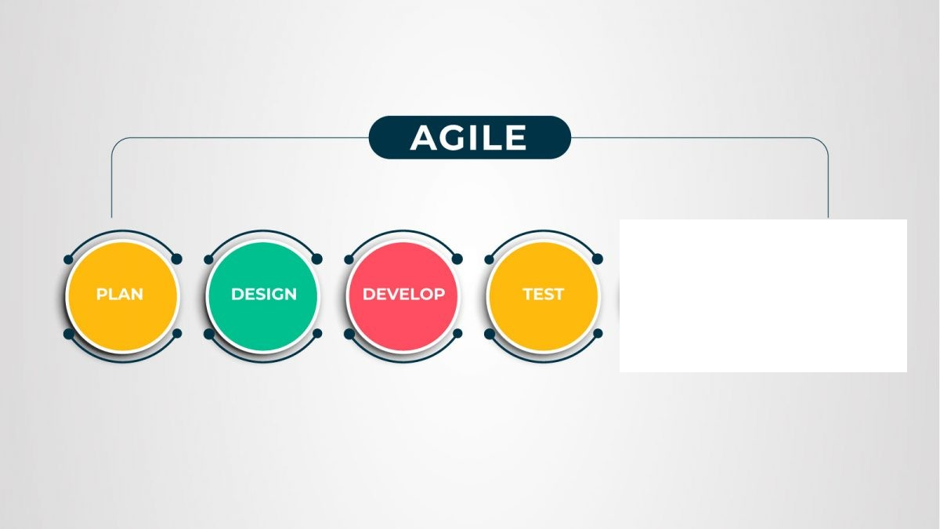
Software Methodologies
Notes:
Testing the developed software
Feedback on testing and appropriate changes are imperative

Slide 48
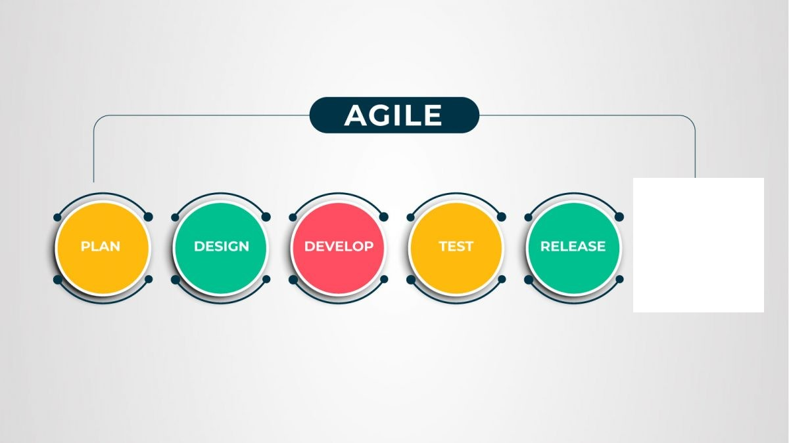
Software Methodologies
Notes:
Release product increments frequently

Slide 49
Software Methodologies
Notes:
Ensure that you are reviewing and monitoring key metrics for success
Receive end-user feedback and implement changes

Slide 50
When is the Agile methodology used?
Notes:
When the requirements will be ongoing, and the scope might change or have potential to change
E.G a payment system

Slide 51


Slide 52
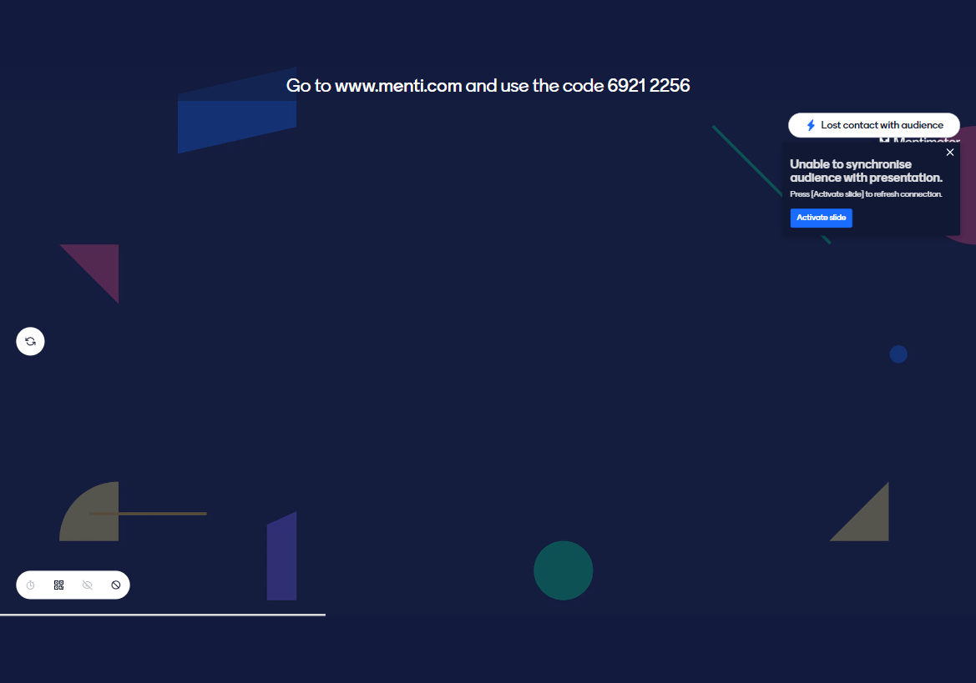

Slide 53
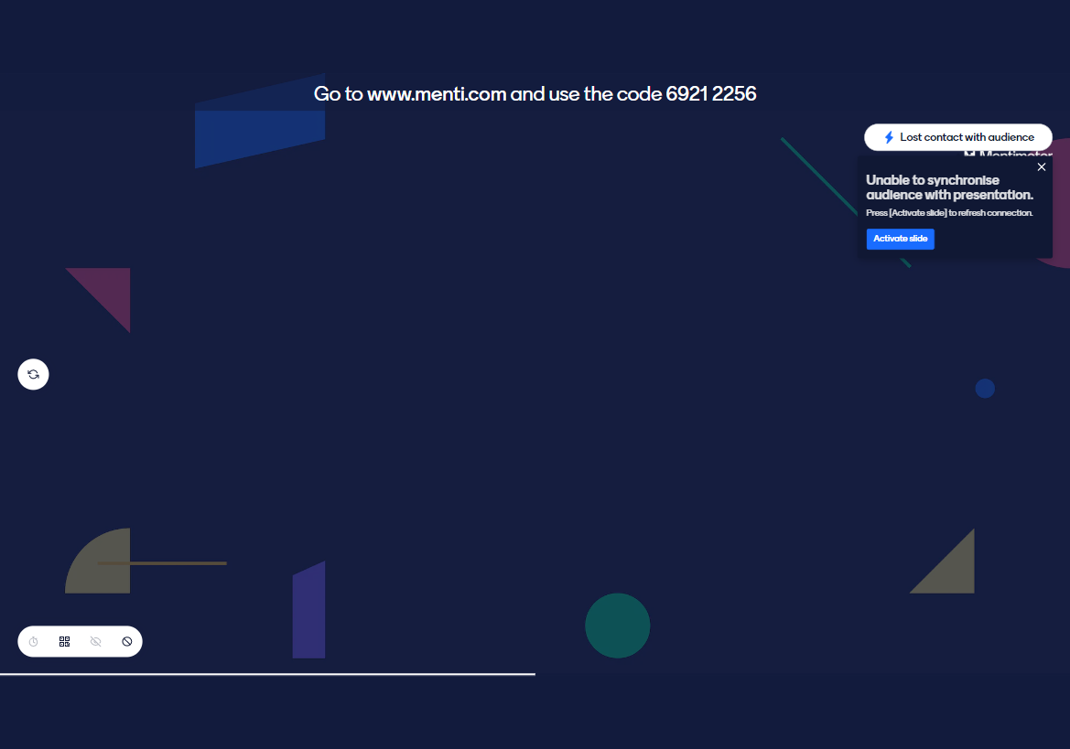

Slide 54


Slide 55
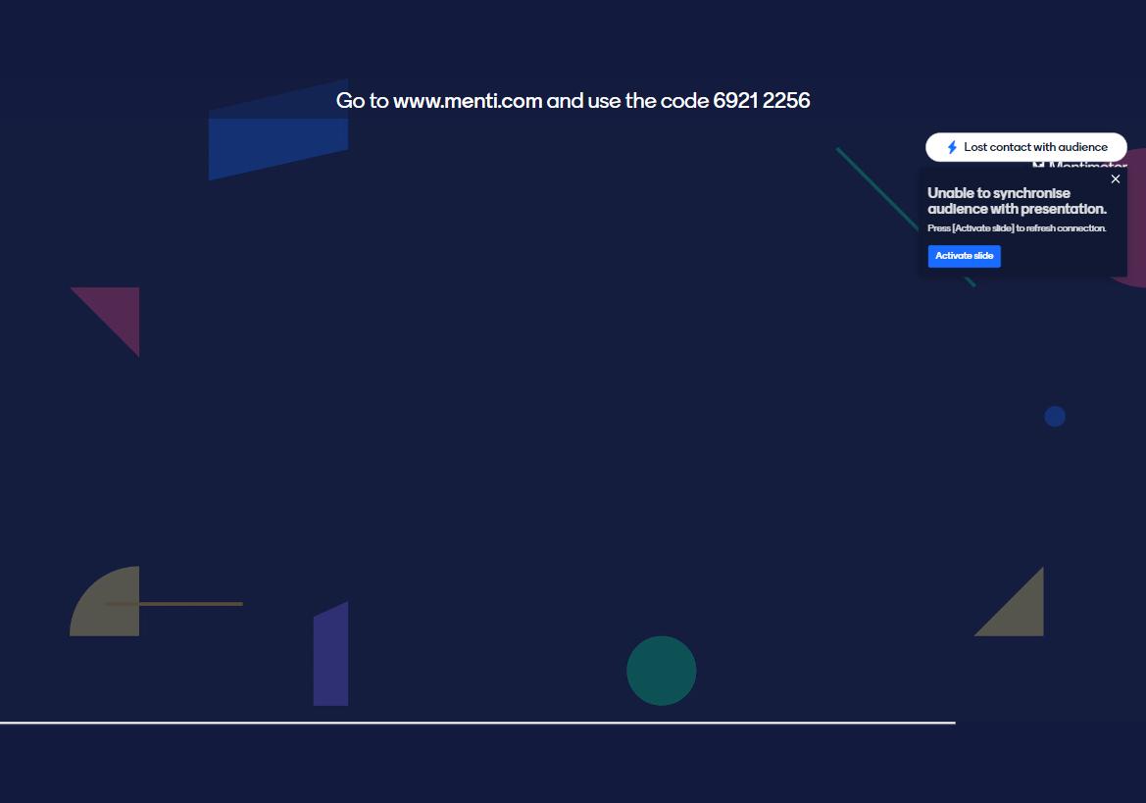

Slide 56


Slide 57
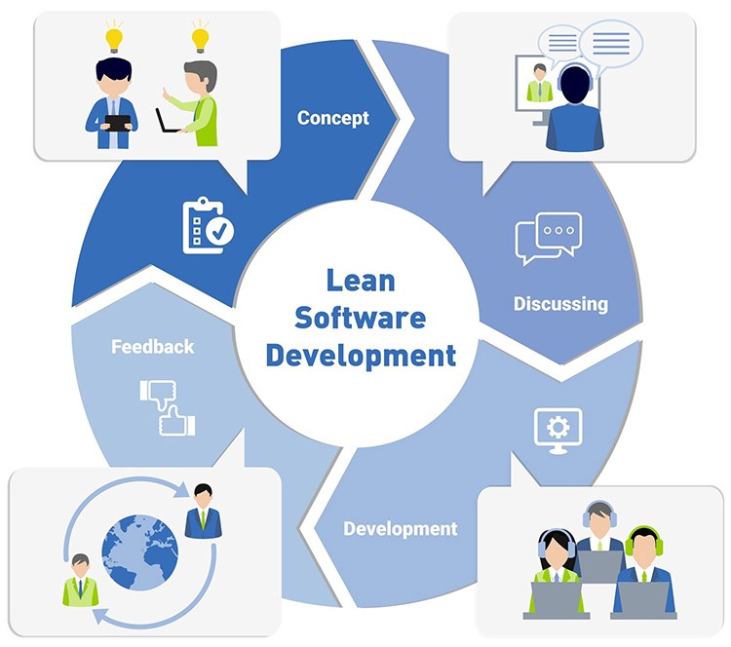
Lean
Software Methodologies
The Lean process is about working only on what must be worked on at the time, so there’s no room for multitasking
Notes:
In short, Lean methodology is a way of optimizing the people, resources, effort, and energy of your organization toward creating value for the customer.
The Lean process is about working only on what must be worked on at the time, so there’s no room for multitasking.
It is based on two guiding tenets, continuous improvement and respect for people.

Slide 58
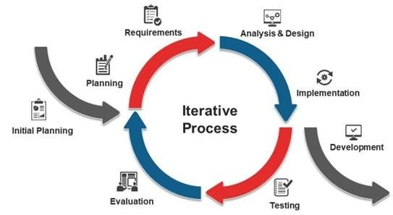
Iterative
Software Methodologies
The Iterative model is repetition incarnate.
Instead of starting with fully known requirements, project teams implement a set of software requirements, then test, evaluate and pinpoint further requirements.
Notes:
A new version of the software is produced with each phase, or iteration. Rinse and repeat until the complete system is ready.

Slide 59
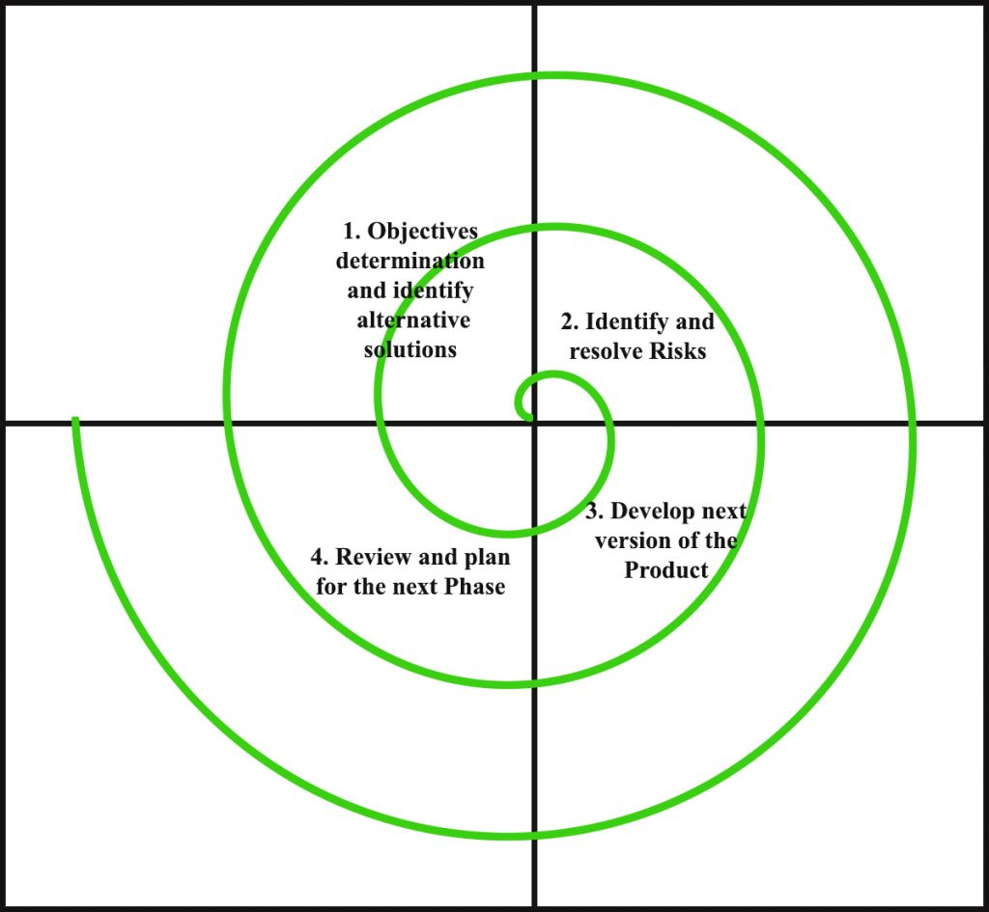
Spiral
Software Methodologies
The project passes through four phases (planning, risk analysis, engineering and evaluation) over and over in a figurative spiral until completed, allowing for multiple rounds of refinement.

Slide 60
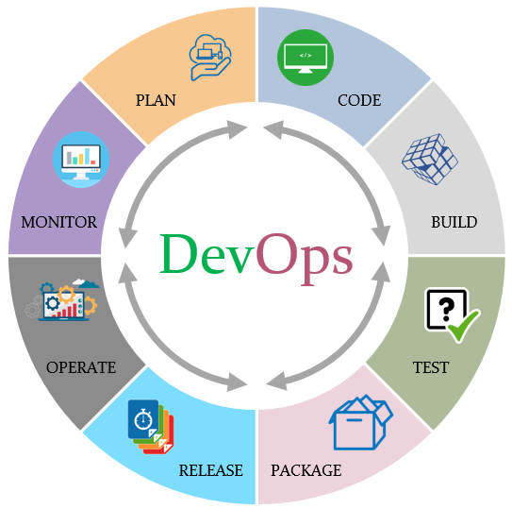
DevOps
Software Methodologies
The DevOps methodology is a relative newcomer to the SDLC scene.
In a DevOps model, Developers and Operations teams work together closely — and sometimes as one team — to accelerate innovation and the deployment of higher-quality and more reliable software products and functionalities.
Notes:
It emerged from two trends: the application of Agile and Lean practices to operations work, and the general shift in business toward seeing the value of collaboration between development and operations staff at all stages of the SDLC process.
In a DevOps model, Developers and Operations teams work together closely — and sometimes as one team — to accelerate innovation and the deployment of higher-quality and more reliable software products and functionalities.

Slide 61
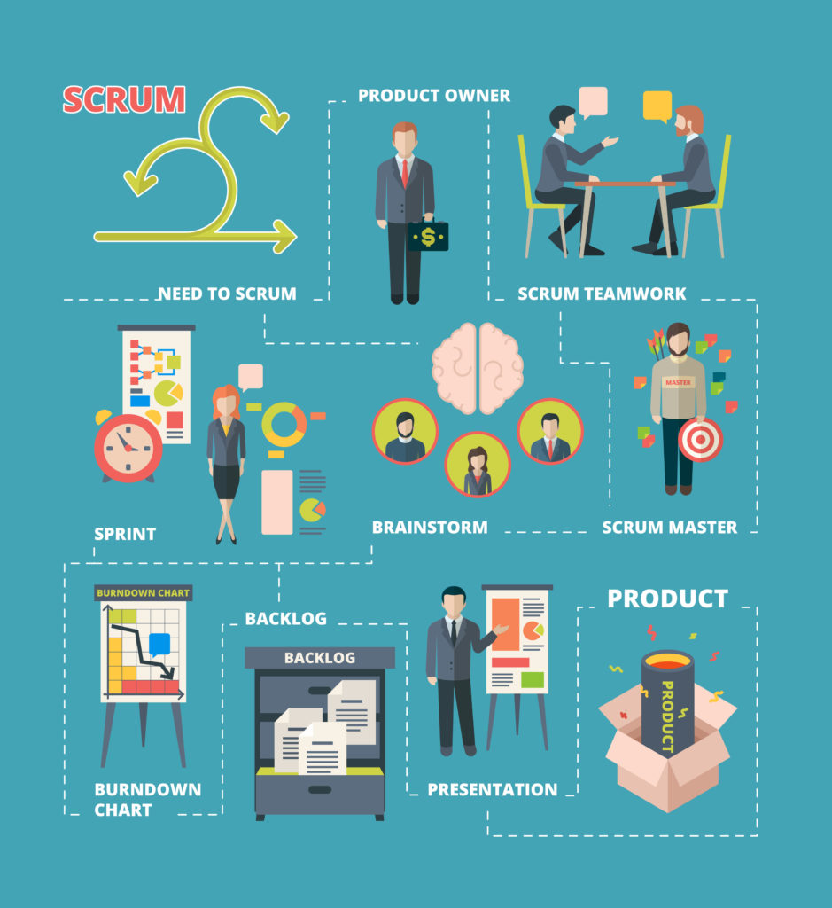
05.
The Scrum Framework

Slide 62
What Is The Scrum Framework
The Scrum Framework
It’s an agile, lightweight process
Can manage and control software and product development
Uses iterative, incremental practices
Has a simple implementation
Increases productivity
Reduces time to benefits
Embraces adaptive, empirical systems development
Embraces the opposite of the waterfall approach…

Slide 63
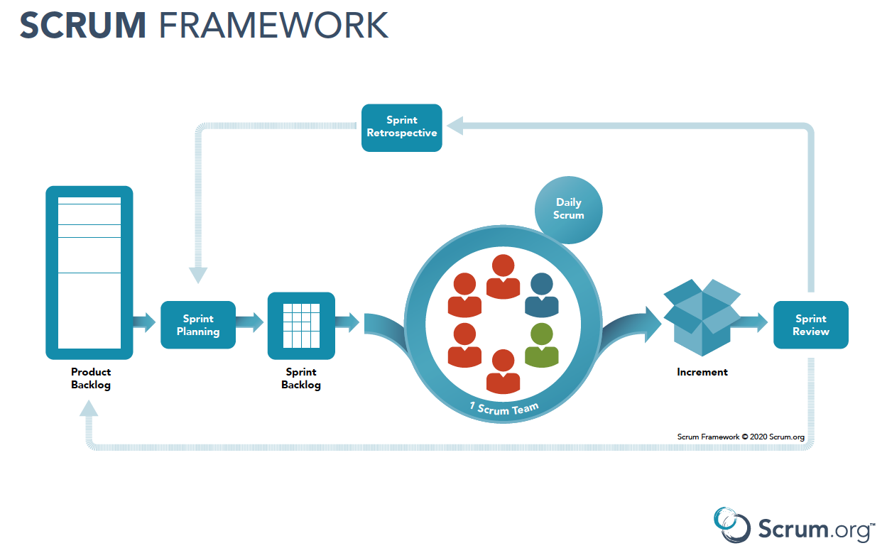
The Scrum Framework
Notes:
Backlog Refinement (2hrs)
Discuss all tickets for an upcoming sprint.
Review tickets on the backlog and ensure that the backlog contains all appropriate tickets, that they are prioritised, and are ready for delivery.
Eliminates deadline vs sizing
Sprint Planning (1hr)
Collaborative process to determine which backlog tickets will be included/handled in the next sprint.
This will be based on priority (deadlines) and team capacity and velocity.
Sprint Reviews(1hr)
This session is to showcase all work that was done in the previous sprint, this will also help teams determine whether additional changes are needed.
This is important to the team as it will allow team members to better understand work that is being done within the sprints and most importantly, to celebrate each other.
We should also use this session to do knowledge shares (small things and big things) on work or new exciting concepts.
Sprint Retrospective (30 min)
This session is to appreciate the good things we managed in the previous sprint.
To identify what did not do well and to see what we can do improve those items for the upcoming sprints

Slide 64
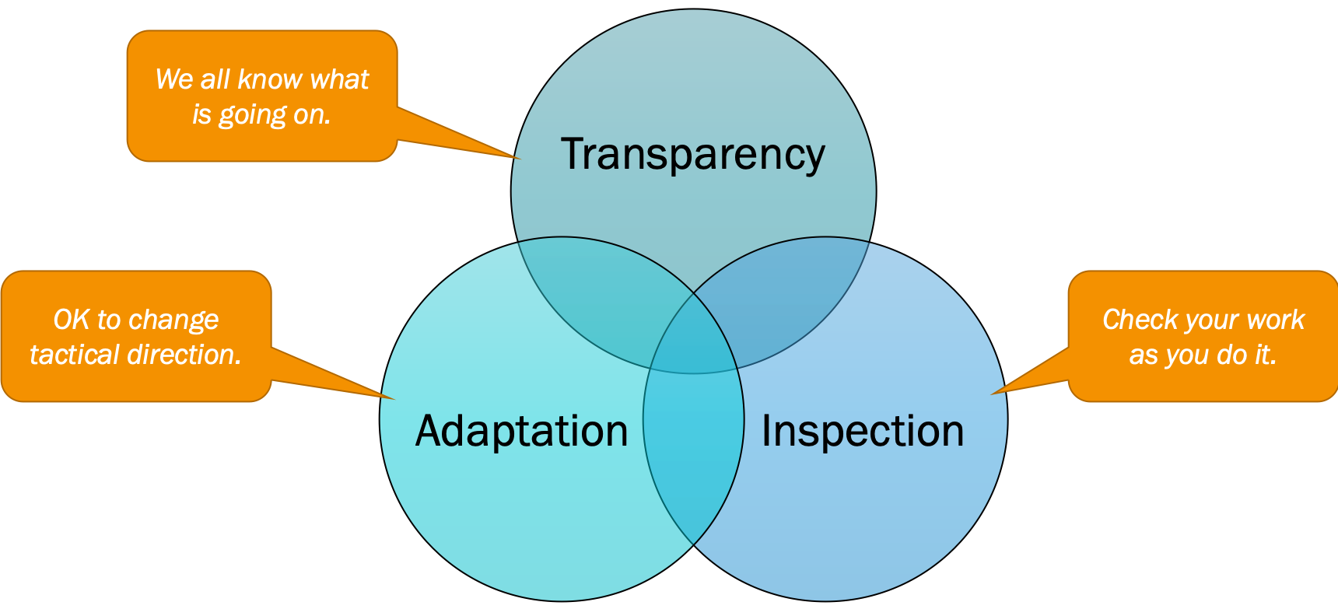
Scrum Three Pillars
The Scrum Framework

Slide 65
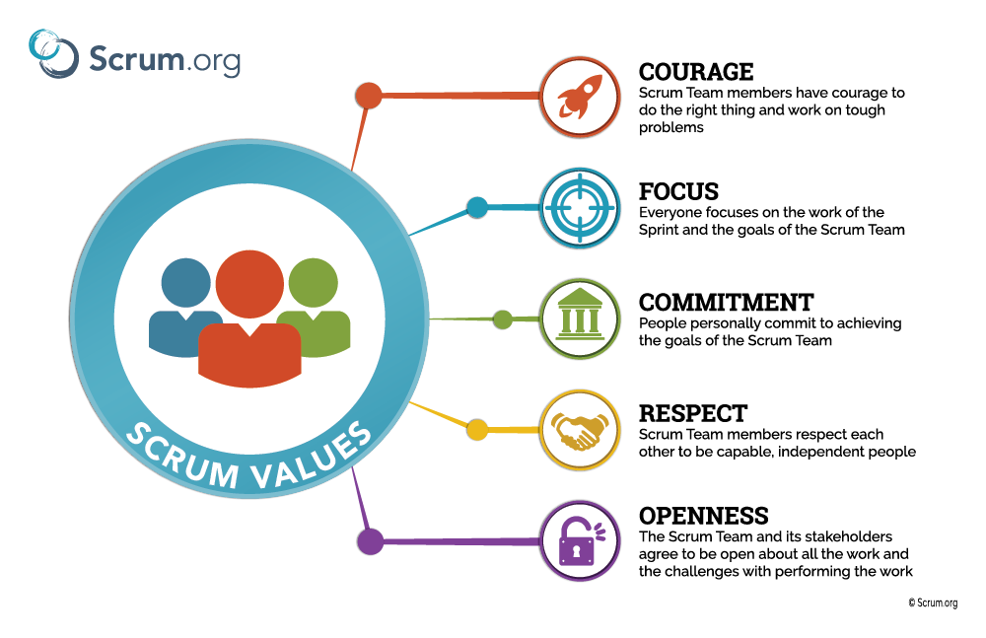
The Scrum Framework
Notes:
-Scrum three pillars

Slide 66


More Frameworks
The Scrum Framework
Notes:
Kanban - Kanban is a popular Lean workflow management method for defining, managing, and improving services that deliver knowledge work.
It helps you visualize work, maximize efficiency, and improve continuously.
SAFe - is and agile framework used to organise the whole organization.

Slide 67
What roles do you think there are in Tech?
The Scrum Framework
Notes:
Kanban - Kanban is a popular Lean workflow management method for defining, managing, and improving services that deliver knowledge work.
It helps you visualize work, maximize efficiency, and improve continuously.
SAFe - is and agile framework used to organise the whole organization.

Slide 68
Careers!?
06.

Slide 69
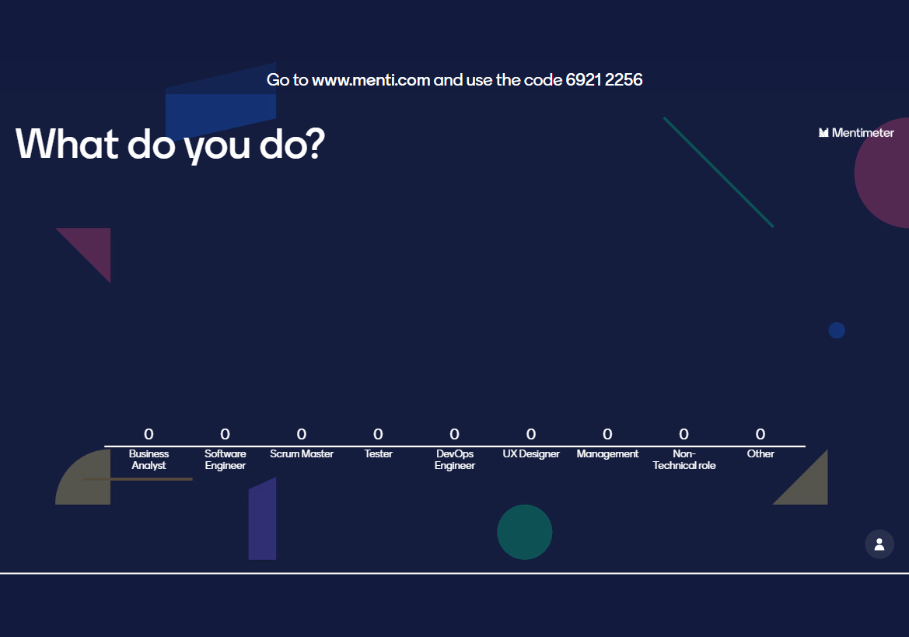
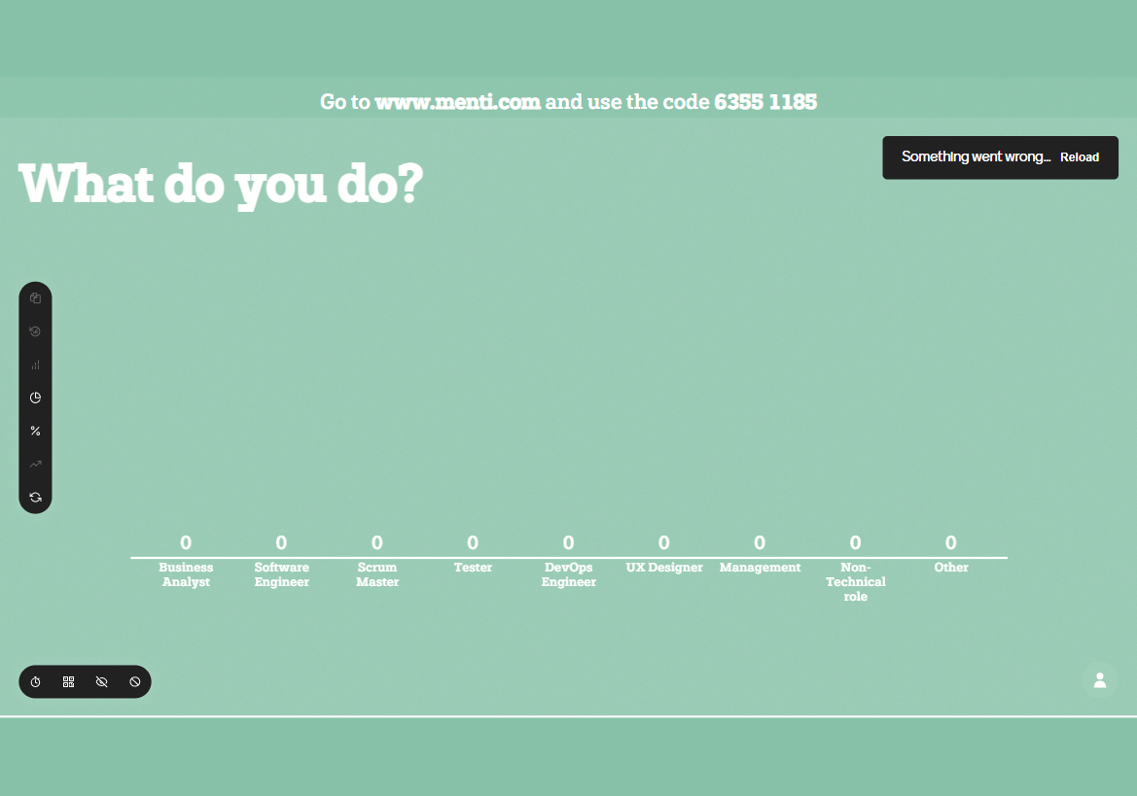
Notes:
Tech and non tech

Slide 70

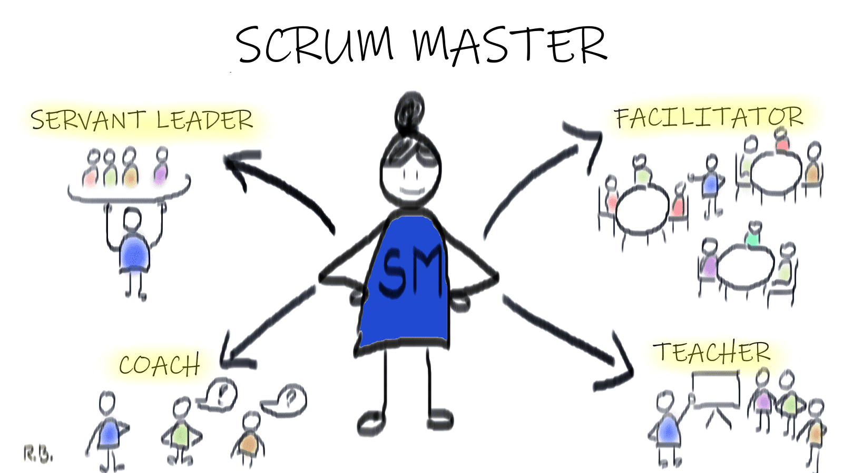
Scrum master
The Scrum Framework
Ensure team coordination and supports project progress

Slide 71
Scrum master
The Scrum Framework
Facilitating scrum ceremonies
Implement scrum best practices
Coach team members and organisations
Remove impediments
Notes:
Adaptive process and requires a lot of skill and judgement
Empirical process
Leant processes
Learning and unlearning

Slide 72
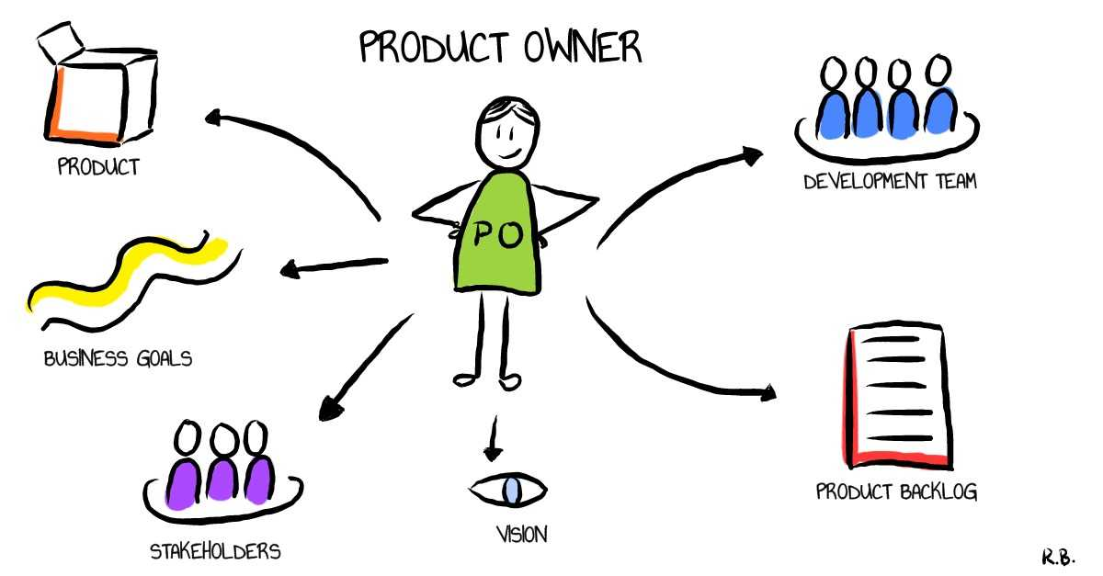
Product Owner
The Scrum Framework
Represent stakeholders & provide direction

Slide 73
Product Onwer
The Scrum Framework
Managing and prioritizing the product backlog
Learning the market and customer needs
Serving as liaison between product and development team
Translating product managers’ strategies to tasks for development team
Notes:
Day to day

Slide 74
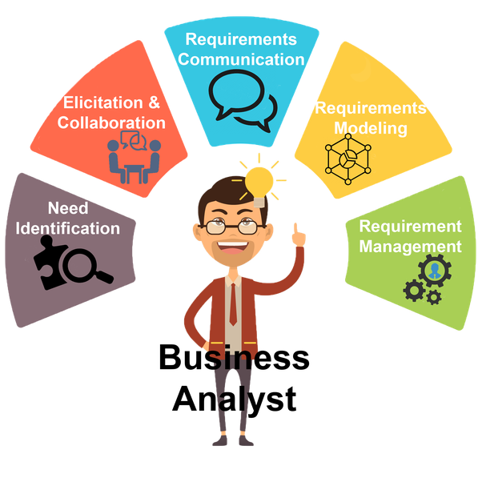
Business Analyst
The Scrum Framework
Works with stakeholders to analyse and document business processes for system to be developed

Slide 75
Business Analyst
The Scrum Framework
Understand the basic business structure and process
Understand the business value proposition
Understand, analyse and interpret business requests
Document and translate business process and requirements
Notes:
Day to day

Slide 76
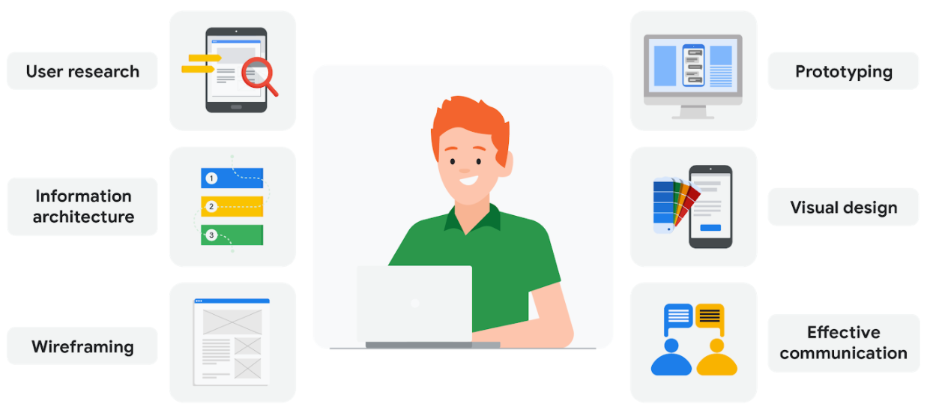
UX Specialist
The Scrum Framework
Ensure best possible user experience

Slide 77
UX Specialist
The Scrum Framework
Customer research
Identify customer needs and pain points
Prototype and wireframing
Manage usability of software

Slide 78
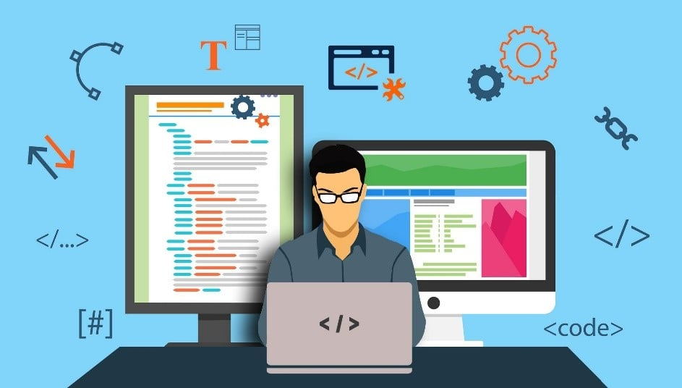
Developers
The Scrum Framework
Individuals who build the required product/features

Slide 79
Developers
The Scrum Framework
Building the product based on requirements given
Choosing programming languages
Estimating the work given
Fixing defects from testing

Slide 80
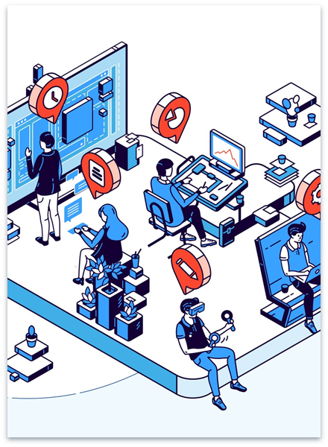
The different roles
The Scrum Framework
Programmers, or coders
Write source code to program computers for specific tasks
Software engineers
Apply engineering principals to build software and systems to solve problems
Software Developers
Implements software development through a coding language and employs testing and maintenance of software
Notes:
These roles interact and overlap, and the dynamics between them vary greatly across development departments and communities.
Programmers, or coders, write source code to program computers for specific tasks like merging databases, processing online orders, conducting searches or displaying text and graphics.
Programmers typically interpret instructions from software developers and engineers.
Software engineers apply engineering principles to build software and systems to solve problems.
They use modeling language and other tools to devise solutions that can often be applied to problems in a general way, as opposed to merely solving for a specific instance or client.
Software engineering solutions adhere to the scientific method and must work in the real world, as with bridges or elevators.
Their responsibility has grown as products have become increasingly more intelligent with the addition of microprocessors, sensors and software.
Software developers have a less formal role than engineers and can be closely involved with specific project areas — including writing code. At the same time, they drive the overall software development lifecycle — including working across functional teams to transform requirements into features, managing development teams and processes, and conducting software testing and maintenance

Slide 81
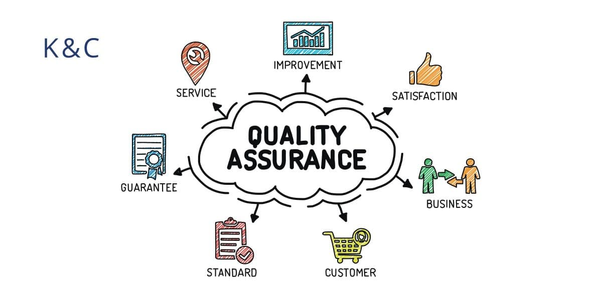
Testers
The Scrum Framework
Responsible for testing the system making sure it works as expected

Slide 82
Testers
The Scrum Framework
Design and execute test cases
Automate testing
Verify defects picked up in testing
Creating and providing feedback on test status, test progress and product quality

Slide 83

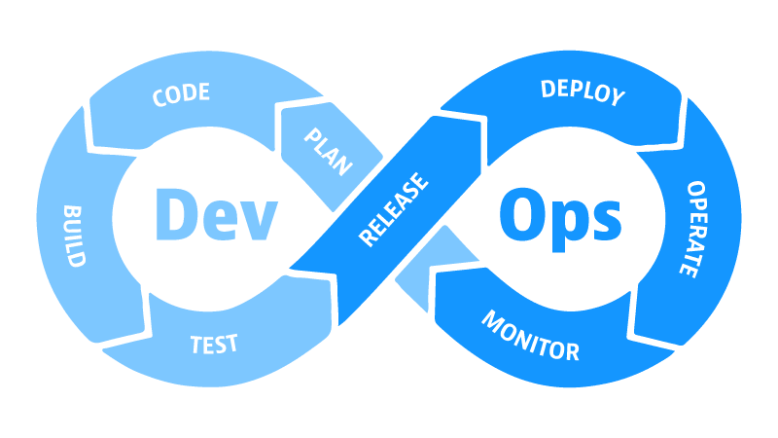
DevOps
The Scrum Framework
Contribute to software maintenance and creation with purpose of making faster updates and writing code that is easy to update and access.

Slide 84
DevOps
The Scrum Framework
Manages software release
Application and infrastructure planning
Monitor the software
Build tools to improve customer experience

Slide 85
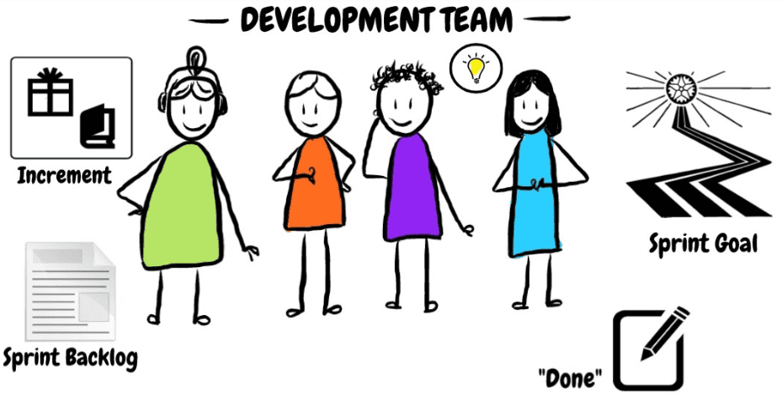
Development team
The Scrum Framework
Notes:
All these roles make up the development team.

Slide 86
Thanks!
Do you have any questions?
aviwe.qata@entelect.co.za

